Slide 1
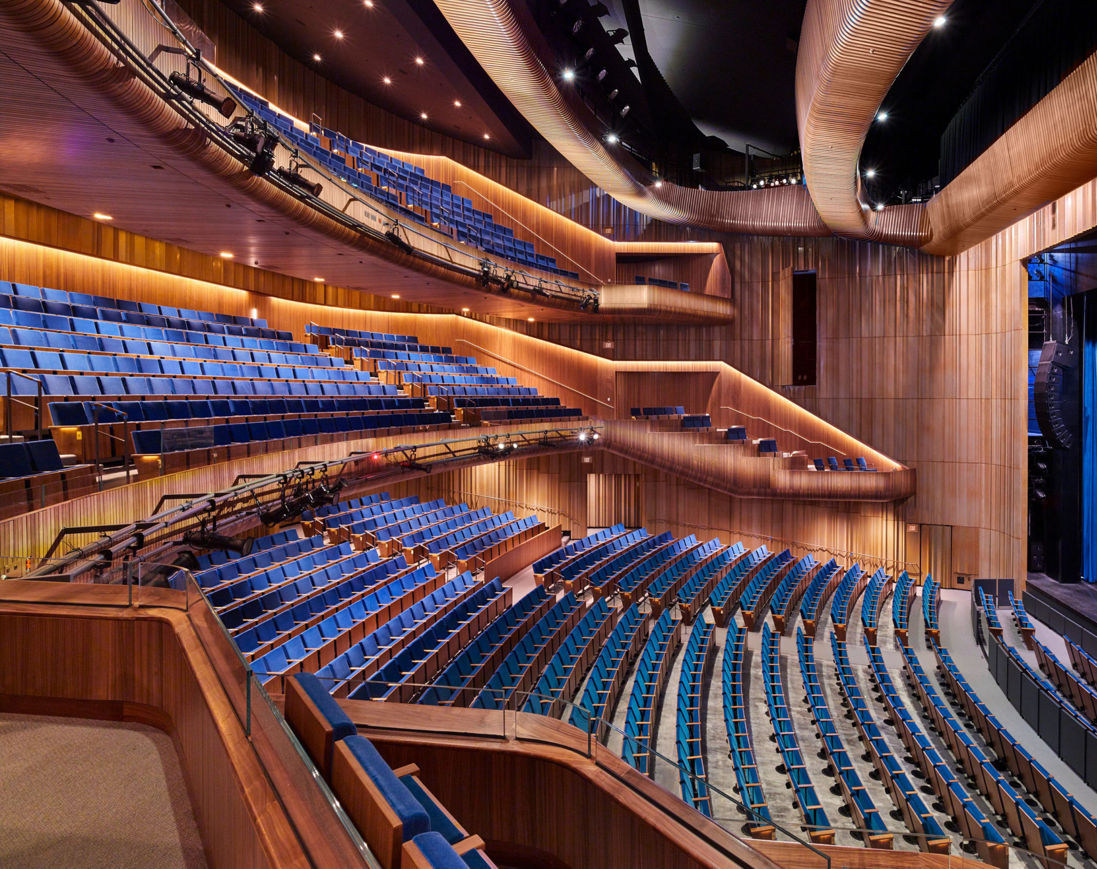
Capital One Hall Season III Community Arts Information Session

Slide 2
Meet Our Speakers
Linda Sullivan, ArtsFairfax
Jonathan Griffith, Capital One Center
Michael Liberman, ArtsFairfax
Lisa Mariam, ArtsFairfax
Stacy Butler, Capital One Hall
Matea Magnano, Capital One Hall
Notes:
Welcome to the Capital One Hall Season 3 Community Arts Information Session
My name is Michael Liberman
I serve on the ArtsFairfax Board of Directors, and I am the former chair of the County Arts Committee
Let me introduce our presenters …
Dalia Palchik, Providence District Supervisor on the Fairfax County Board of Supervisors, and Capital One Hall is located in her district
Linda Sullivan, President and CEO, ArtsFairfax
Jonathan Griffith, Managing Director, Capital One Center
[Insert ASM staff]
And, Lisa Mariam, Senior Director of Grants and Services, ArtsFairfax

Slide 3
Capital One Hall Staff
Stacy Butler, General Manager
Matea Magnano, Liaison between Capital One Hall and ArtsFairfax
Jordan Young, Technical Director
IJ Rosenblum, Director of Operations
Heidi Kibirsky, Director of Marketing
Larry Silver, Director of Finance
Laura Reed-Orr, Director of Food and Beverage
Jacque Holt, Box Office Manager

Slide 4
ArtsFairfax is a 501(c)(3) nonprofit charitable organization, incorporated in 1964 as Fairfax County’s designated local arts agency. ArtsFairfax is funded in part by Fairfax County, as well as corporations, foundations, individuals, the Virginia Commission for the Arts, and the National Endowment for the Arts.
Mission:
ArtsFairfax is the voice of the arts, dedicated to fostering dynamic and diverse local arts, ensuring that arts thrive by providing vision, leadership, capacity building services, advocacy, funding, education, and information.

Slide 5
History of the Project
Fairfax County comprehensive plan called for a community center
Capital One and Fairfax County agree on building a performing arts center
$11 million value of the community center applied to public use at the performing arts center
County and charitable, arts, nonprofit, and other civic organizations can apply to use Capital One Center (“Public Facility Users”)
Capital One Hall Opened in Fall 2021
Notes:
The Comprehensive Plan originally called community center at this location valued at approximately $11 million
Both Capital One and Fairfax County wanted to do something more and instead they agreed to construct a performing arts center with the $11 million value of the community center applied to a portion of the time at the performing arts center
The Agreement allocates usage of Capital One Hall to the County and charitable, arts, nonprofit, and other civic organizations that the County deems eligible to use Capital One Center (collectively with the County known as the “Public Facility Users”)

Slide 6
Allocated Season III Dates
Main Hall 25 days
Black Box 57 days
Classrooms 220 days
Notes:
Under this arrangement, during the third season the Main Hall is available to Public Facility Users 25 days; the Black Box 57 days; and the Classrooms 220 days
Capital One calculates total value of this allocation to be equivalent to the amortized value of about $11.2 million over the length of the Agreement
I first got involved with the project in 2015 when conceptual design was in the planning stages. In 2017 the Board of Supervisors approved the land use application and the Agreement, and construction began shortly thereafter. The facility opened with the first public performances in October 2021.
Next Linda Sullivan will talk about the role of ArtsFairfax

Slide 7
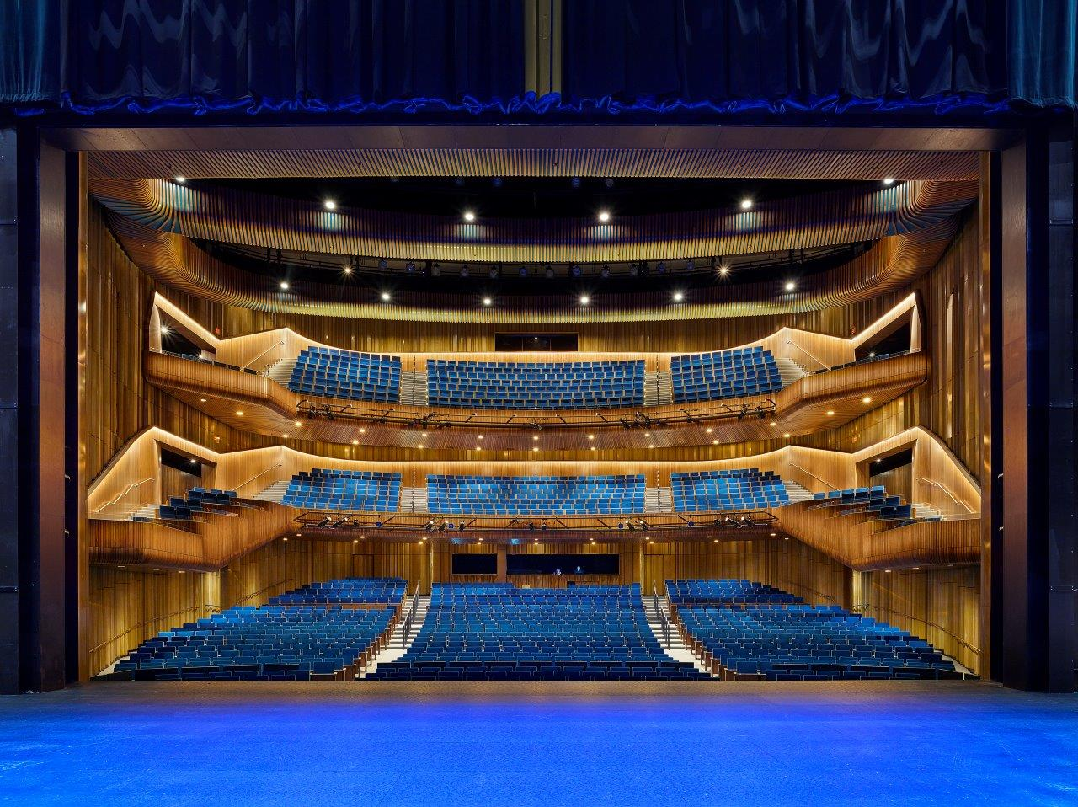
Main Theater
The performance hall has a capacity of 1,600 seats and is designed for Broadway productions as well as concerts and other performances.

Slide 8
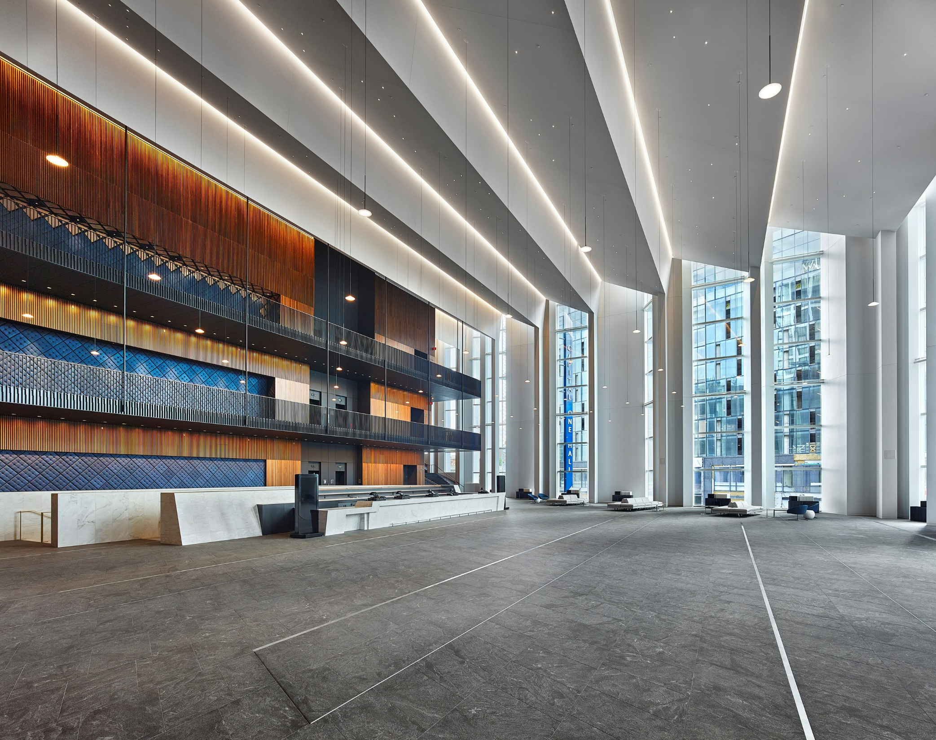
The Atrium
The large atrium space is perfect for events and weddings and is designed to accommodate up to 400 people at tables or 900 standing.

Slide 9
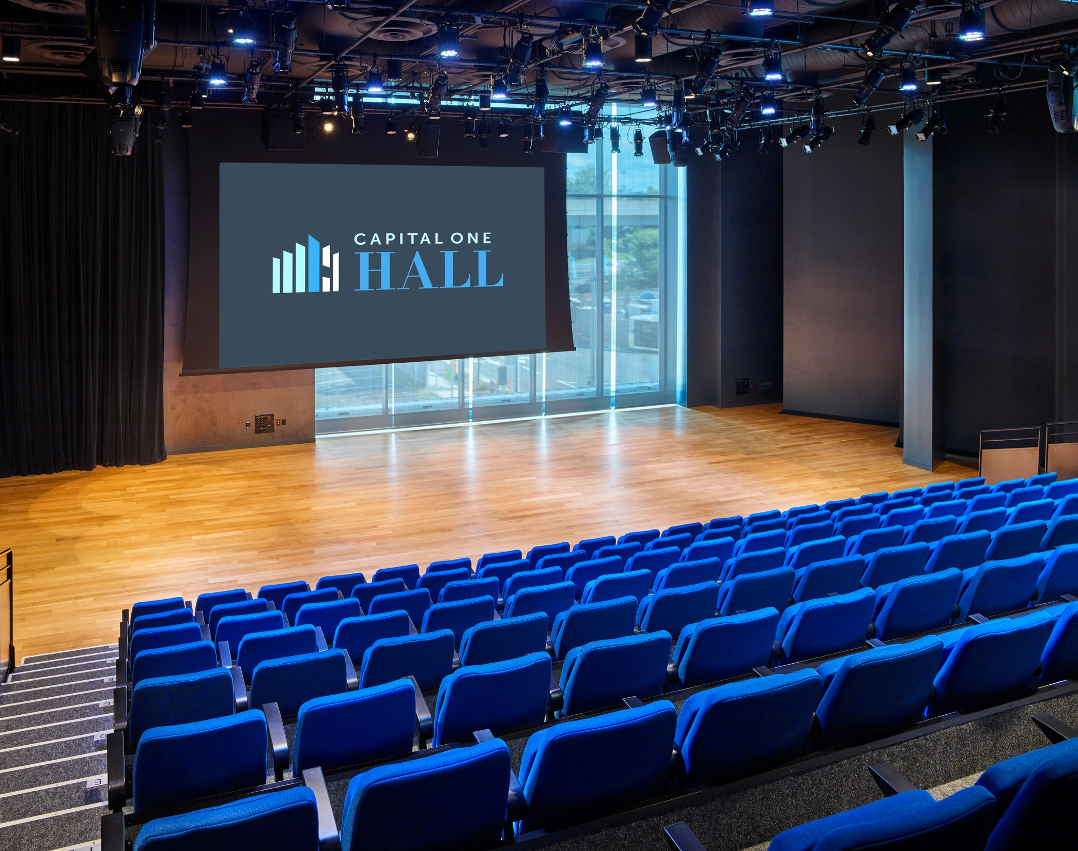
The Vault
The Vault black box theater has a capacity of 225 seats and is designed for intimate performances and plays as well as concerts and other events.

Slide 11
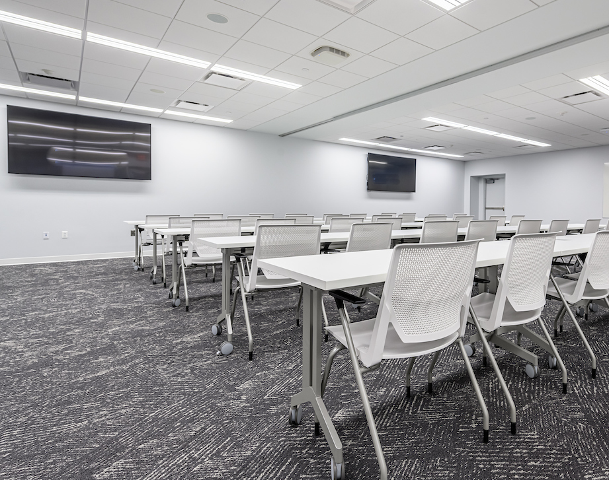
Dual Classrooms
On the first floor of Capital One Hall are classroom style meeting rooms. These can hold large groups of people for events and meetings.
Seating Capacity: 50

Slide 12
Technical Capabilities With Jordan & IJ

Slide 13
Application Process With Lisa Mariam

Slide 14
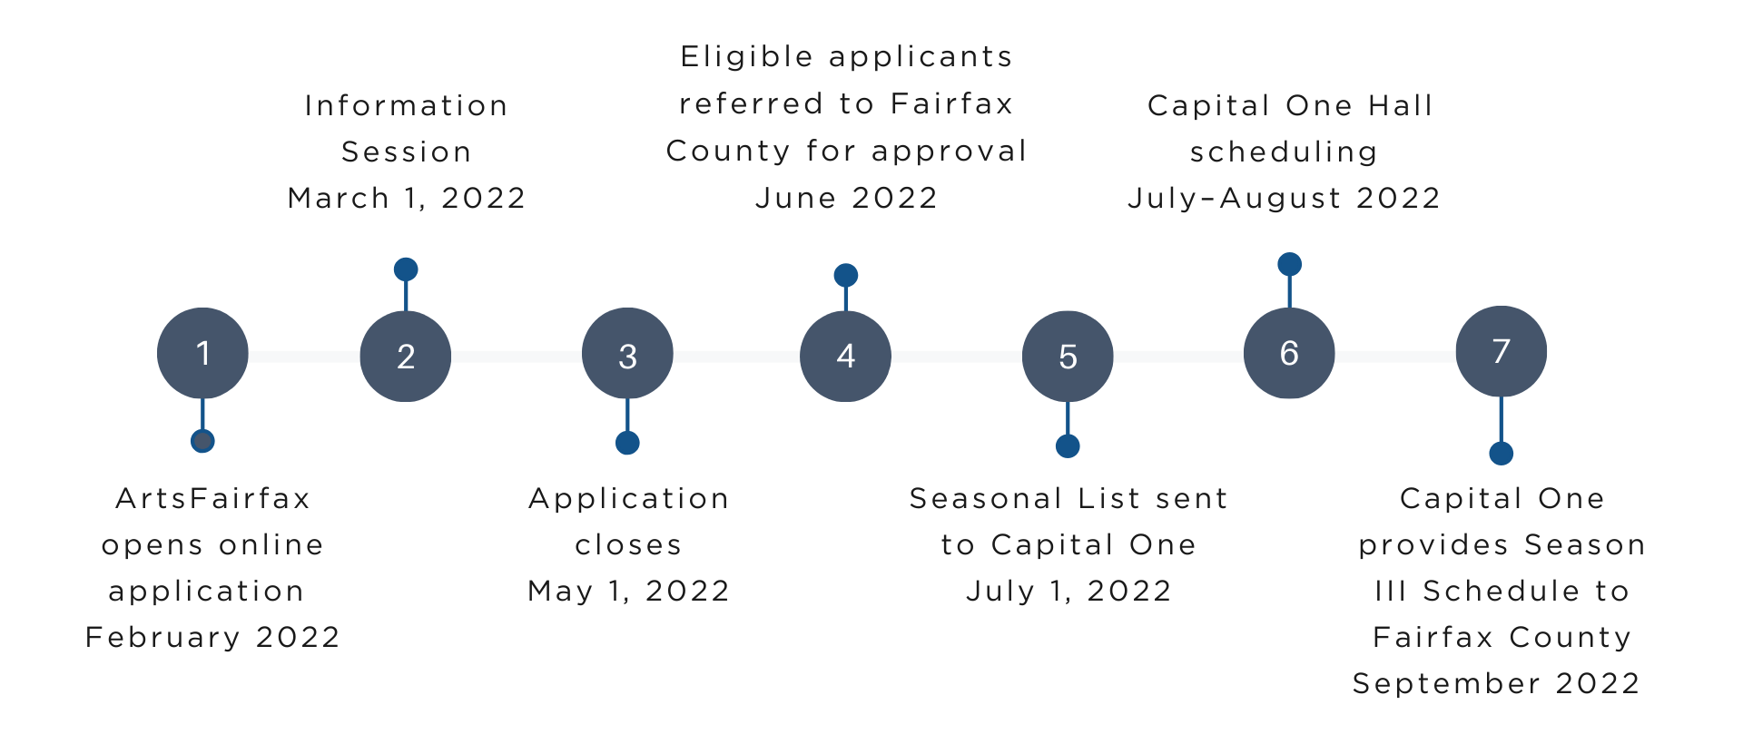
Season III Timeline

Slide 15
User Reservation Process
When Capital One Hall has received the seasonal list, we review and award dates
All organizations that applied will be contacted by October 1, 2022
Capital One Hall will create a diverse season
Once the date(s) have been awarded, Capital One will reach out to each organization to start contracting for the date(s)

Slide 16
Box Office & Marketing
Ticket Build Form
Marketing Collateral
Layered artwork
Show blurb
Social handles
Official website URL
Once these materials are submitted, we will announce your show and tickets on sale.

Slide 17
Timeline of Your Event
Arrival/Load in- Organization chooses (As early as 8am)
Box Office- Opens 3 hours prior to showtime
Front doors and Concessions- Opens 1 hour prior to showtime
House doors- Organization chooses (Typical is 30 minutes prior to showtime)
Concessions- Closes after intermission ends

Slide 18
Fairfax County Users Expense Fee
Main Theater Rent - $1,950
Included under Rent:
Police – (1) if required.
EMT – (1) if required.
Event Security
Security /Bag Checkers: 4 people for 4 hours each
Ushers /Ticket Takers: 6 people for 4 hours each
In House Sound & Lights
Box Office – 2 people for 4 hours each
Production Manager – 1 person for 6 hours
Event House Keeping: 1 person for 6 hours
Post Show Cleaning: up to $750
The Vault Rent - $500
Included under Rent:
Police – (1) if required.
EMT – (1) if required.
Event Security
Ushers /Ticket Takers: 4 people for 3 hours each
In House Sound & Lights
Box Office – 1 person for 4 hours
Production / Event Cleaning – 1 pp for 6 hours
Post Show Cleaning: up to $350
Classrooms - $100 full day; $50 half day slot – 6:00am to Noon or Noon to 6pm. Variant of day slot is full day rate.
Included under Rent:
Production / Event Cleaning – 1 pp for 4 hours
Post Show Cleaning: up to $100

Slide 19
Concessions
House selection of beer, wine, and nonalcoholic beverages
Individually packaged snacks and candy
Concession staffing will be determined based on ticket sales
*Note- All menu items are chosen at Capital One Hall’s discretion*
Catering Needs
All food and beverage must come through Capital One Hall’s in-house catering
Catering and Sales Manager to be notified of all catering needs
Examples:
Pre-show dinners, post-show receptions/toasts, backstage catering, water bottle cases

Slide 20
Production and Operations (Advancing Process)
1 month prior
Initial email explaining all current information of the event
Riders and stage plots are greatly appreciated
2 weeks prior
Logistics of timing and needs with Production Manager
Operations Checklist Sheet returned
Food and Beverage needs discussed

Slide 21
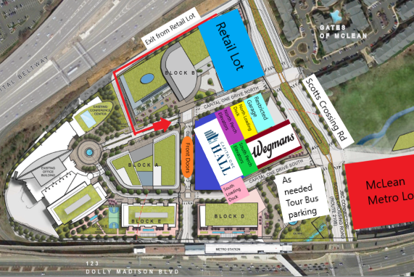
Parking McLean Metro Lot- Staff and Performers Restricted Lot- Patrons North Loading Dock

Slide 22
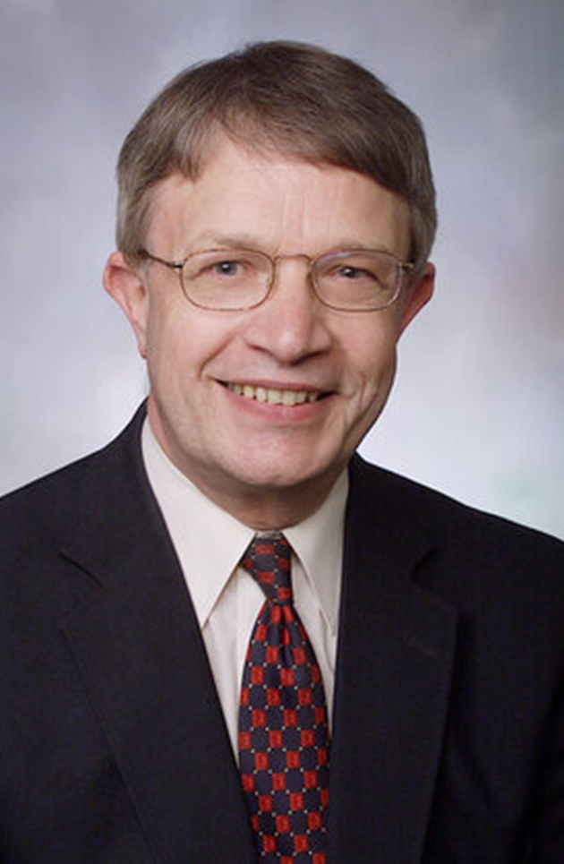
Dr. Graham Elliott American Youth Philharmonic Orchestras (AYPO)

Slide 23
Questions?

Slide 24
Capital One Hall Guided Tour

